Slide 1
Analytics Drives Insights Insurance Industry
Rui Fan
Emily Rechan
July 2017
Notes:
Good afternoon, my name is Emily Rechan and I am a technical specialist here at IBM. I specifically focus on business analytics with a concentration in Cognos and Watson Analytics. Rui Fan also is on the call today, she acts as a data scientist at IBM and specializes in Data Science Experience. We are both very excited to have the opportunity to speak with you and appreciate you taking the time to listen in.
Today, we want to share with you how to gain more from your data and how to reach a higher level of competitive insight.
Good afternoon, my name is Emily Rechan and I am a technical specialist here at IBM. I specifically focus on business analytics with a concentration in Cognos and Watson Analytics. Rui Fan also is on the call today, she acts as a data scientist at IBM and specializes in Data Science Experience. We are both very excited to have the opportunity to speak with you and appreciate you taking the time to listen in.
Today, we want to share with you how to gain more from your data and how to reach a higher level of competitive insight.

Slide 2
Goals
Overview
Agenda
Demo
Discussion
Notes:
In order to do so, We will first review your company goals, second we can discussion how our partnership will allow both of our business’ to grow, and conclude with a demo. After, we can discuss any questions not addressed during the demo, but please feel free to interject at any point. This will ultimately assist us in creating next steps and moving forward together.
To start off, lets first discuss your company’s current environment and any concerns you may have.
As the final decision maker at your company, you mentioned ….

Slide 3



Ease of Use
Deep Insights
Increase employee collaboration
Decrease high risk customers by 5%
Business Analyst
Data
Scientist
Notes:
Your business analysts and data scientists are having a difficult time collaborating together as they work on completely separate platforms and the data across the organization is siloed. This is ultimately affecting your bottom line because your unable to effectively rate your customers risk level when it comes to changing or creating existing and new car insurance coverage.
The two main aspects you want to concentrate on in a new platform are:
Ease of use for your business analysts
- Obtaining deep insights for your data scientists
Each of these aspects will allow for your company to better analyze specific customers, while creating better car insurance policies. In todays demo, I will take on the role of the business analyst while Rui acts as the data scientist.
Now, If there are any other concepts you would like us to expand on please let me know as we go through the demo.

Slide 4
Data Consolidation
01
Connection
02
Analysis
03
Notes:
To begin I think it is important to note the process we are going to see here today. This includes taking our data and consolidating it.

Slide 5
D E M O

Slide 6
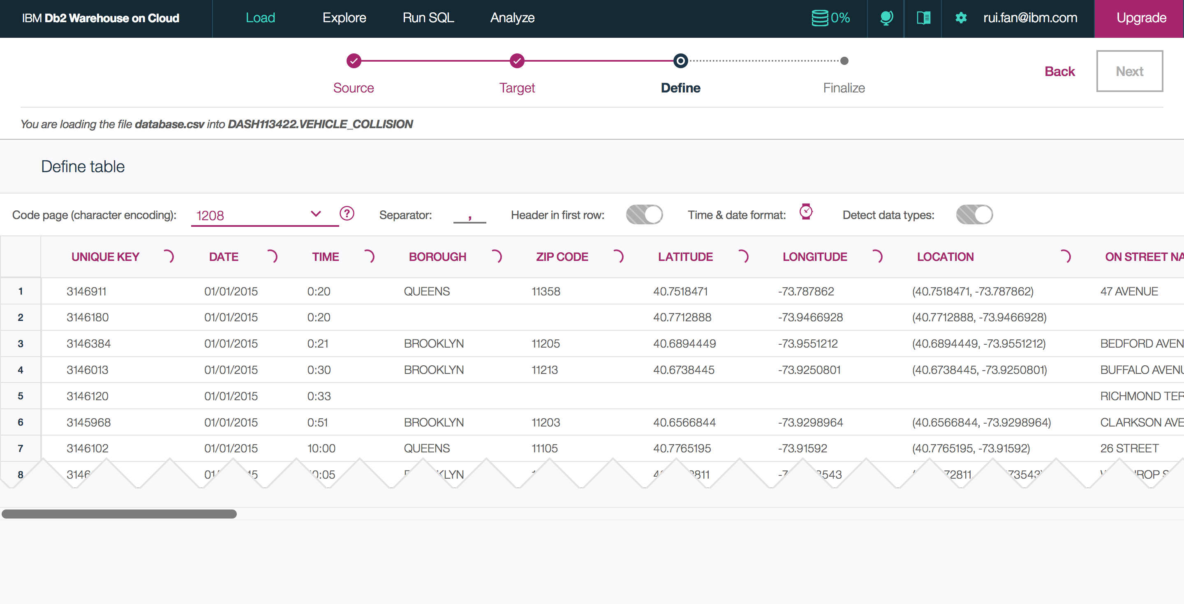
Database Consolidation

Slide 7
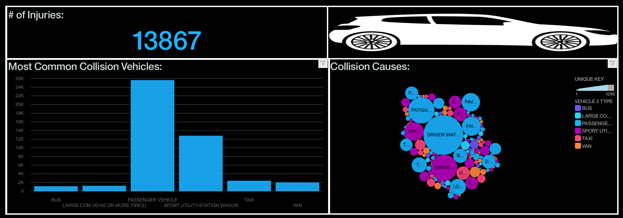
Business Analyst

Slide 8
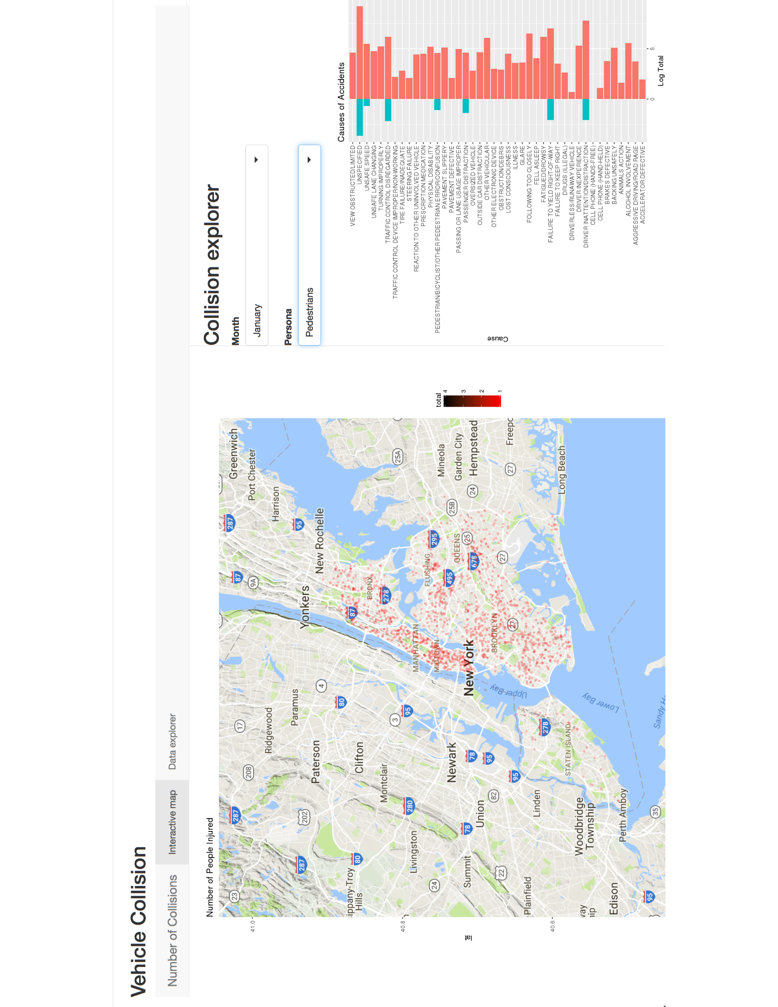
Data Scientist

Slide 9
Emily Rechan
Emily.rechan@ibm.com
347-839-1324
Analytics Technical Specialist
Rui Fan
Rui.fan@ibm.com
201-978-5700
Data Scientist

